Slide 1
Introduction to CSS3

Slide 2


Today's Learning Objectives
Introduction to CSS and its syntax.
Inline, internal, and external CSS.
Selectors: element selectors, class selectors, ID selectors.
Basic styling properties: color, background, font, margin, padding.
CSS box model.

Slide 3
Introduction to CSS and its syntax.

Slide 4
CSS
Cascading Style Sheets, is a language used to define the presentation and layout of HTML elements on a webpage.
It determines how HTML elements are displayed on screen, paper, or other media devices.
CSS is essential for controlling the design, layout, and responsiveness of web pages.
CSS is used to style web pages, providing a way to define various visual aspects such as colors, fonts, spacing, and layout.
It allows developers to create consistent and visually appealing designs across multiple web pages.

Slide 5
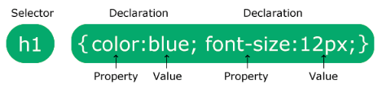
CSS Syntax
A CSS Rule has two main parts: a Selector and one or more declarations:
CSS syntax follows a simple structure:
Selector (specifies the element to style)
{ } (curly braces enclose the style declarations)
Property: value; (each declaration defines a style attribute)

Slide 6
CSS Syntax
CSS declarations always end with the semicolon, and all the declarations are surrounded by curly braces:
p {color: red; text-align: center;}
To make the CSS more readable, you can put one declaration on each line, like this:
p {
color: red;
text-align: center;
}

Slide 7
Types of CSS

Slide 8
Types of CSS
There are three types of cascading style sheets:
Internal style sheet
External style sheet
In Line style

Slide 9
Internal Style Sheet
Styles are written within the <style> tag in the <head> section of the HTML document.
Useful for single-page styles or when styles are specific to one document.
Advantages:
Easier to manage styles specific to one page.
No need for external file linking.
Disadvantages:
Not reusable across multiple pages.
Can increase page load time for larger styles.

Slide 10
External Style Sheet
Styles are written in a separate .css file and linked within the <head> section of the HTML document.
Ideal for multi-page websites to maintain a consistent look and feel.
Advantages:
Reusable across multiple pages.
Reduces code duplication.
Improves page load time once the CSS file is cached.
Disadvantages:
Requires an additional HTTP request.
No styles applied if the CSS file is not loaded properly.

Slide 11
Inline Style
Inline styles are used to apply unique styles to individual elements.
Inline styles are defined using the style attribute directly within the HTML element.
Advantages:
Inline CSS overrides the the Internal and External CSS
No need to create a another file as external CSS
Disadvantages:
Adding style element to every HTML element is time consuming
It can be difficult to maintain consistency and make global style updates.

Slide 12
Question:
Where would you use an inline style?
A) To apply a quick, one-off style to a single HTML element.
B) To style multiple pages consistently.
C) To separate content from presentation.
D) To maintain a large website with consistent design.

Slide 13
Question:
Where would you use an inline style?
A) To apply a quick, one-off style to a single HTML element.
B) To style multiple pages consistently.
C) To separate content from presentation.
D) To maintain a large website with consistent design.

Slide 14
Question:
What are the advantages of using an external stylesheet?
A) It increases the size of the HTML document.
B) It makes it easier to maintain and update styles across multiple pages.
C) It allows for quick one-off styles.
D) It hides the styles from the user.

Slide 15
Question:
What are the advantages of using an external stylesheet?
A) It increases the size of the HTML document.
B) It makes it easier to maintain and update styles across multiple pages.
C) It allows for quick one-off styles.
D) It hides the styles from the user.

Slide 16
Selectors in CSS

Slide 17
Types of Selectors in CSS
There are three major types of CSS Selector
Element Selector
Class Selector
ID Selector
Universal Selector

Slide 18
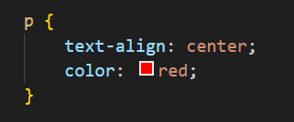
Element Selector
The element selector selects HTML elements based on their element name
This example selects all <p> elements and applies center alignment and red color to their text.

Slide 19
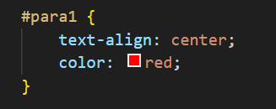
ID Selector
The ID selector selects an HTML element based on its unique ID attribute.
To select an element with a specific ID, use the hash (#) character followed by the ID name.
This example selects the HTML element with id="para1" and applies center alignment and red color to it.

Slide 20
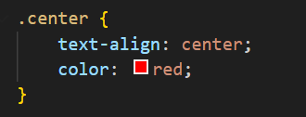
Class Selector
The class selector selects HTML elements with a specific class attribute.
To select elements with a specific class, use the period (.) character followed by the class name.
This example selects all HTML elements with class="center" and applies center alignment and red color to them.

Slide 21
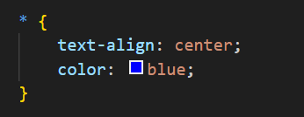
Universal Selector
The universal selector (*) selects all HTML elements on the page.
This example applies center alignment and blue color to all HTML elements.

Slide 22
Styling Properties

Slide 23
Basic Styling Properties in CSS
Color
Background
Font
Margin
Padding

Slide 24


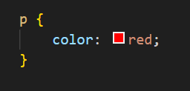
Color
The color property sets the text color of an element.
You can specify colors using predefined color names (e.g., red, blue) or hexadecimal color codes (#RRGGBB).

Slide 25
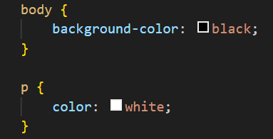

Background Color
The background-color property defines the background color of an element.
You can set background colors using predefined color names or hexadecimal color codes.

Slide 26
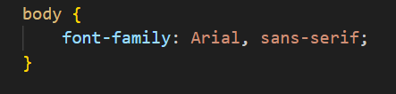
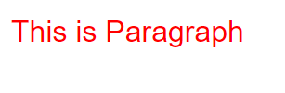
Font Family
The font-family property specifies the font used for text content within an element.
You can specify multiple font families as a fallback in case the first choice is not available.

Slide 27
Margin
The margin property controls the outer space around an element.
You can set margins for all sides of an element or individually for each side (top, right, bottom, left).
Margin values can be specified in various units such as pixels (px), percentages (%), or em units.
Parent Div
Child Div
Margin-left : 50px;

Slide 28
Types of Margin
Individual Margins:
margin-top: value;
margin-right: value;
margin-bottom: value;
margin-left: value;
Shorthand Margin:
margin: 10px 15px 20px 25px; (Top, Right, Bottom, Left)
margin: 10px 15px; (Vertical Horizontal)
margin: 10px; (All sides)

Slide 29
Padding
The padding property sets the space between an element's content and its border.
Like margins, padding values can be specified for all sides or individually for each side.
padding: 10px;
Content

Slide 30
Types of Padding
Uniform Padding:
padding: value;
Applies the same padding to all sides of the element.
Individual Padding:
padding-top: value;
padding-right: value;
padding-bottom: value;
padding-left: value;
Allows specifying different padding values for each side of the element.

Slide 31
CSS Box Model

Slide 32
Box Model
Margin
Border
Padding
Content

Slide 33
Box Model
Content:
The innermost area of an element where the actual content, such as text or images, is displayed.
Padding:
Space between the content and the border.
Used to create space inside the element.
Border:
A border surrounding the padding and content.
Defines the visual boundary of the element.
Margin:
Space outside the border.
Creates space between adjacent elements.

Slide 34
Question:
Which of the following best describes CSS?
A) A scripting language for creating dynamic web content
B) A markup language for defining the structure of web documents
C) A programming language for building interactive web applications
D) A styling language for controlling the appearance of HTML elements

Slide 35
Question:
Which of the following best describes CSS?
A) A scripting language for creating dynamic web content
B) A markup language for defining the structure of web documents
C) A programming language for building interactive web applications
D) A styling language for controlling the appearance of HTML elements

Slide 36
Questions:
Which CSS syntax is used to define internal styles?
A) <style>...</style> tags within the <head> section
B) Using the style attribute directly within HTML elements
C) Linking an external .css file using the <link> tag
D) Defining styles within a <div> element

Slide 37
Questions:
Which CSS syntax is used to define internal styles?
A) <style>...</style> tags within the <head> section
B) Using the style attribute directly within HTML elements
C) Linking an external .css file using the <link> tag
D) Defining styles within a <div> element

Slide 38



Slide 39
Thank You
Copyright © Upgrad., All rights reserved
Confidential Information, intended for approved distribution list of Upgrad

